Slide 1




“ งานใหม่ใกล้ฉัน ” New jobs near me
ICS-Dept.
10 Apr. 25
1
Auto application access
Notes:
Good afternoon, everyone. My name is Satawat from the ICS
Today, I’ll be presenting on Small Group Activity and our team’s name is 'New Jobs Near Me'

Slide 2









ICS-Dept.
10 Apr. 25
2
Agenda
Organization
01
Action plan
05
Activity Brainstorming
02
Activity Operation
06
Motivation of Activity
03
Result Activity
07
Objective and Target (Goal)
04
Next Action
08
Notes:
Agenda การนำเสนอในครั้งนี้จะเริ่มจาก Organization ไปจนถึง Objective and Target
The agenda for today’s presentation will start with an overview of the organization, followed by the objectives and targets

Slide 3


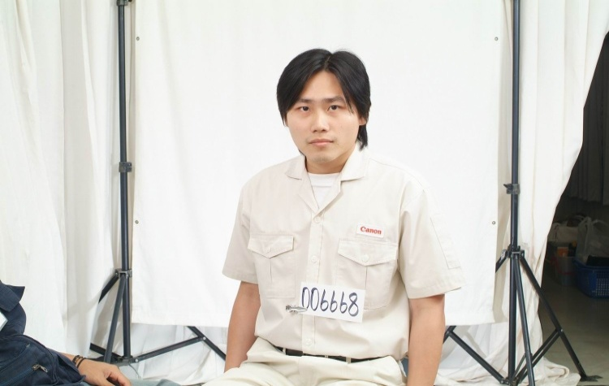
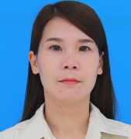
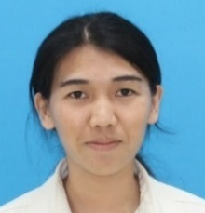
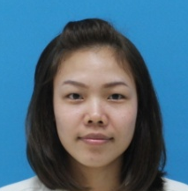
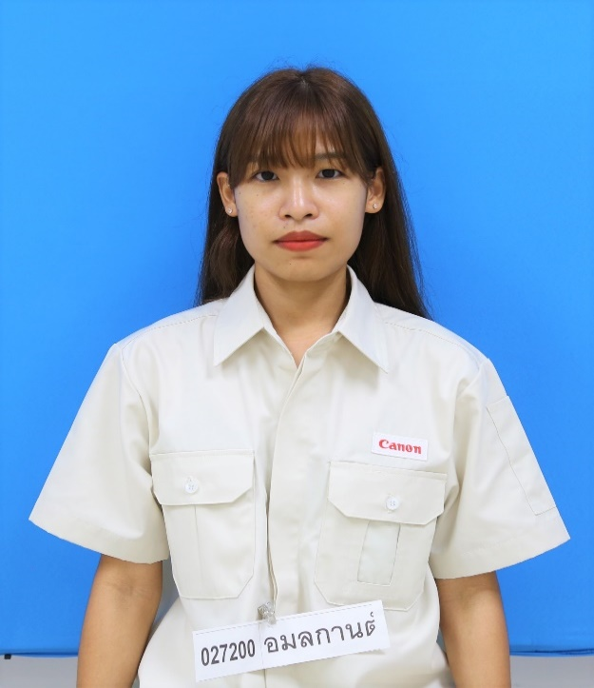
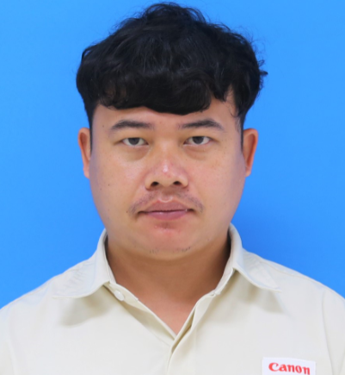
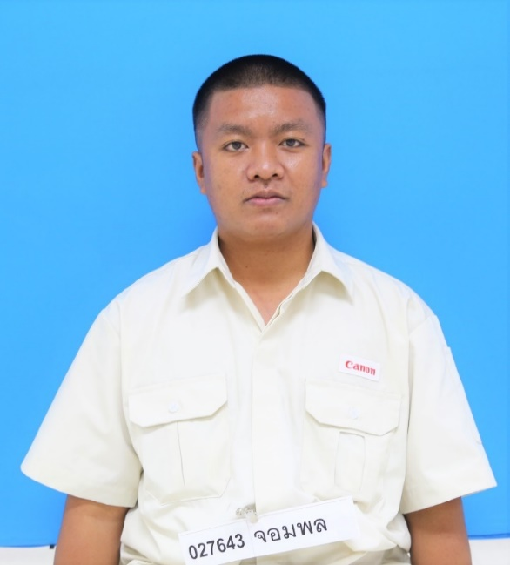

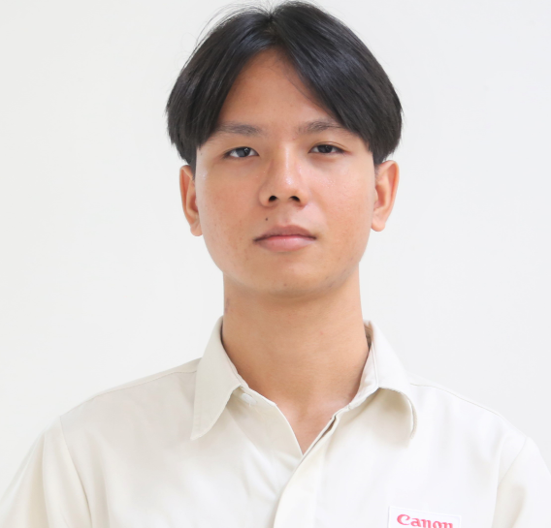
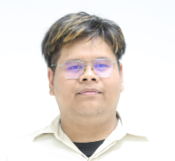
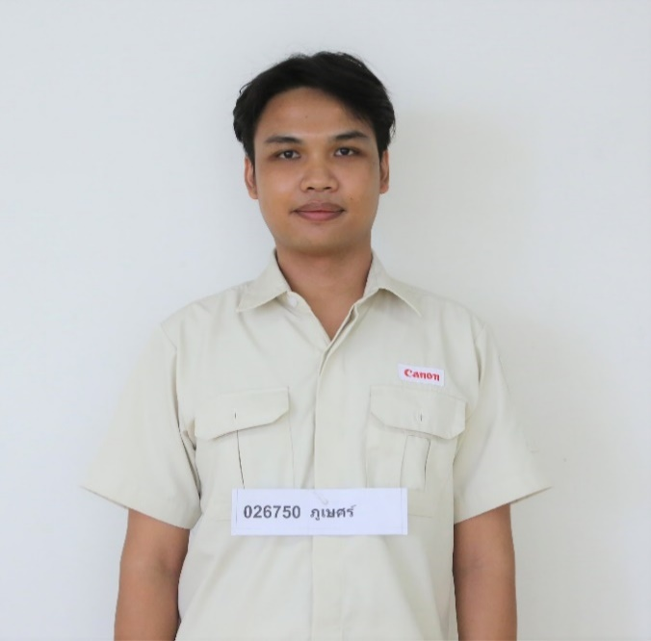
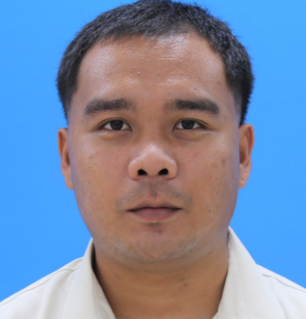
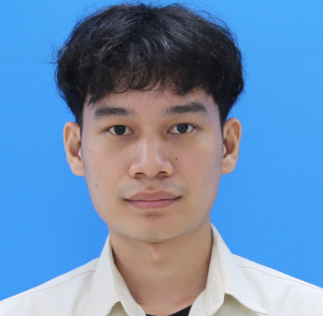
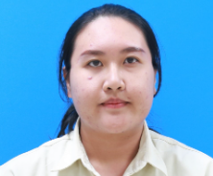
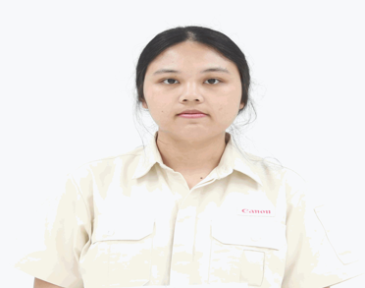

ICS-Dept.
10 Apr. 25
3
Organization
Advisor
Coach
Leader
Sub Leader
MR.SANCHAI
MS.NAREE
MS.ALISA
MS.SARUDA
MS. AMOLAKARN
MR. TEERAPON
MR.JOMPHON
MR. JAKKRIT
MR. CHANOKCHON
MR.PHUBET
MR.ATTAPON
MR. SATAWWAT
MS. NATTHANIT
MS. SASIKAN
Notes:
โดยorganization จะประกอบด้วย advisor คือ Mr.sanchai , Coach คือ Ms.naree , leader group คือ Ms.Alisa, Sub leader คือ Ms.Saruda และสมาชิกภายในทีมตามนี้
"The organization consists of our advisor, Mr. Sanchai, our coach, Ms. Naree, the group leader, Ms. Alisa and the rest of the team members as follows."

Slide 4

ICS-Dept.
10 Apr. 25
4
Activity Brainstorming
No. | Topic | Good Point | Weak Point | Status
1. | Improvement reservation room (C,D,M) | 1. Reduce workload ICS member to modify room.(Add, Update, Delete) 2. User can manage by self for Easy & short time to period | 1. ICS has workload to Develop program more than merit Reduce workload. 2. The frequency of user requests is low (2024 :10 request)
2. | Test system by Robot (Q,C) | 1.Reduce workload ICS member to test system. | 1.The system is frequently modified, need to modify Robot to accommodate
3. | 5S Folder (Q,C,M) | 1.Increase space on file server 2.Easy & short time to access document | 1. Consider difficult file management access 2. There is a chance of error and data loss.
4. | “Auto application access” (C,D,S) | 1.Reduce workload ICS member for register user to system. 2.Reduce mistake of operation register 3.Data security | 1.Not all system can auto register.
Notes:
After brainstorming within our team, we decided to choose the topic of Auto Application Access for our activity

Slide 5
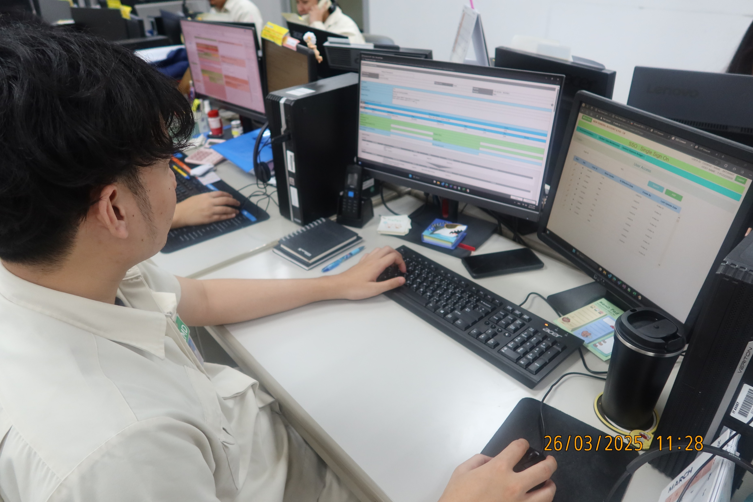
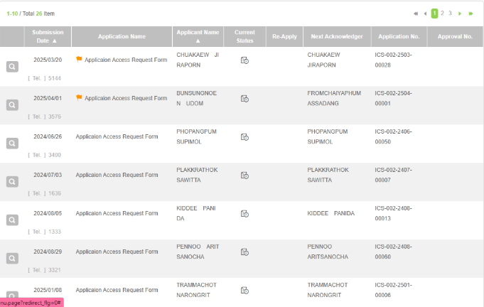
Motivation of Activity
ICS-Dept.
10 Apr. 25
5
The system in CHT has a large volume, and ICS must control access rights for all systems. Therefore, there are most requests that need to be handled daily, which is a daily job that must be done every day.
Therefore, the group has the idea to change it to an automated format to reduce the workload in operations
Notes:
เนื่องจากระบบของ CHT มีจำนวนมาก ICS จึงต้องรับผิดชอบในการควบคุมสิทธิ์การเข้าถึงของผู้ใช้งานในทุกระบบ ซึ่งส่งผลให้มีคำร้องขอเข้ามาจำนวนมากในแต่ละวัน และกลายเป็นงานประจำที่ต้องดำเนินการอย่างต่อเนื่องทุกวัน
"With so many systems in CHT, ICS is in charge of making sure the right people have the right access. This means we deal with a lot of requests every day — it’s something we have to keep up with regularly."
"So, the team came up with the idea of turning this process into an automated one to help reduce the workload and make things run more smoothly."

Slide 6




Motivation of Activity
ICS-Dept.
10 Apr. 25
6
BEFORE
AFTER
USER
USER
User issue FlowLites
User issue FlowLites
ICS
PROGRAM
ICS
1.ICS Check user already exists and approve
2 min / user
1.ICS Check user already exists and approve
1 min / user
ICS
PROGRAM
ICS
2.ICS Register menu SSO
2.ICS Register menu SSO
1 min / user
2 min / user
ICS
PROGRAM
ICS
3.ICS Register role system
and approve
3 min / user
3.ICS Register role system
and approve
1.5 min / user
USER
USER
Can use system
Can use system
TOTAL WORKLOAD : 7 Min / user
TOTAL WORKLOAD : 3.5 Min / user
Notes:
แรงจูงใจของกิจกรรม
เดิมที่ process การจัดการเกี่ยวกับ application access จะใช้ Workload ทั้งสิ้น 7 นาทีต่อ User และหลังจากทำกิจกรรมแล้วจะคาดว่าจะช่วยลดworkloadลงเหลือ 3.5 นาทีต่อuser
2.โดยstepที่จะทำการเปลี่ยนแปลงจะเป็น...................(อธิบายFlowที่จะทำการเปลี่ยนในส่วนBefore)
3.โดยจะทำการนำโปแกรมมาจัดการในstepทั้งหมดที่กล่าวมาเพื่อเปลี่ยนให้เป็นautomation
Initially, the process of managing application access took a workload of 7 minutes per user. After the activity, we expect to reduce the workload to 3.5 minutes per user.
The steps for making the changes will be as follows.
First step ICS Check user already exists and approve used to take 2 minutes per user and
next step ICS Register menu SSO used to take 2 minutes per user
and ICS Register role system and approve used to take 3 minutes per user.
Therefore ,We will implement a program to handle all the steps mentioned and transform them into an automated process.

Slide 7



ICS-Dept.
10 Apr. 25
7
Objective and Target
3 min
TOTAL application in 2024 : 1,313 user
Workload : 9,191 Min (153 Hr.)
2 min
2 min
1.5 min
Estimate workload 2025 : 1,313 user
Workload : 4,595 Min (76 Hr.)
1 min
1 min
Objective :
Reduce workload in operation register user.
Target :
Reduce workload 50%
3.5 MIN /Application
Notes:
วัตถุประสงค์และเป้าหมาย
"That’s all for my presentation. Thank you for listening. Do you have any questions?"

